Slide 1
Inheritance, Polymorphism, and Interfaces

Slide 2
Inheritance
Inheritance allows a new class to extend an existing class.
The new class inherits the members of the class it extends.
It helps to specialize a class from an existing class.
bumblebees class and grasshoppers class are two specialized classes of insects class
It helps to generalize common members of many classes into a parent class
poodle, terrier, and shepher have common characteristics of a dog

Slide 3
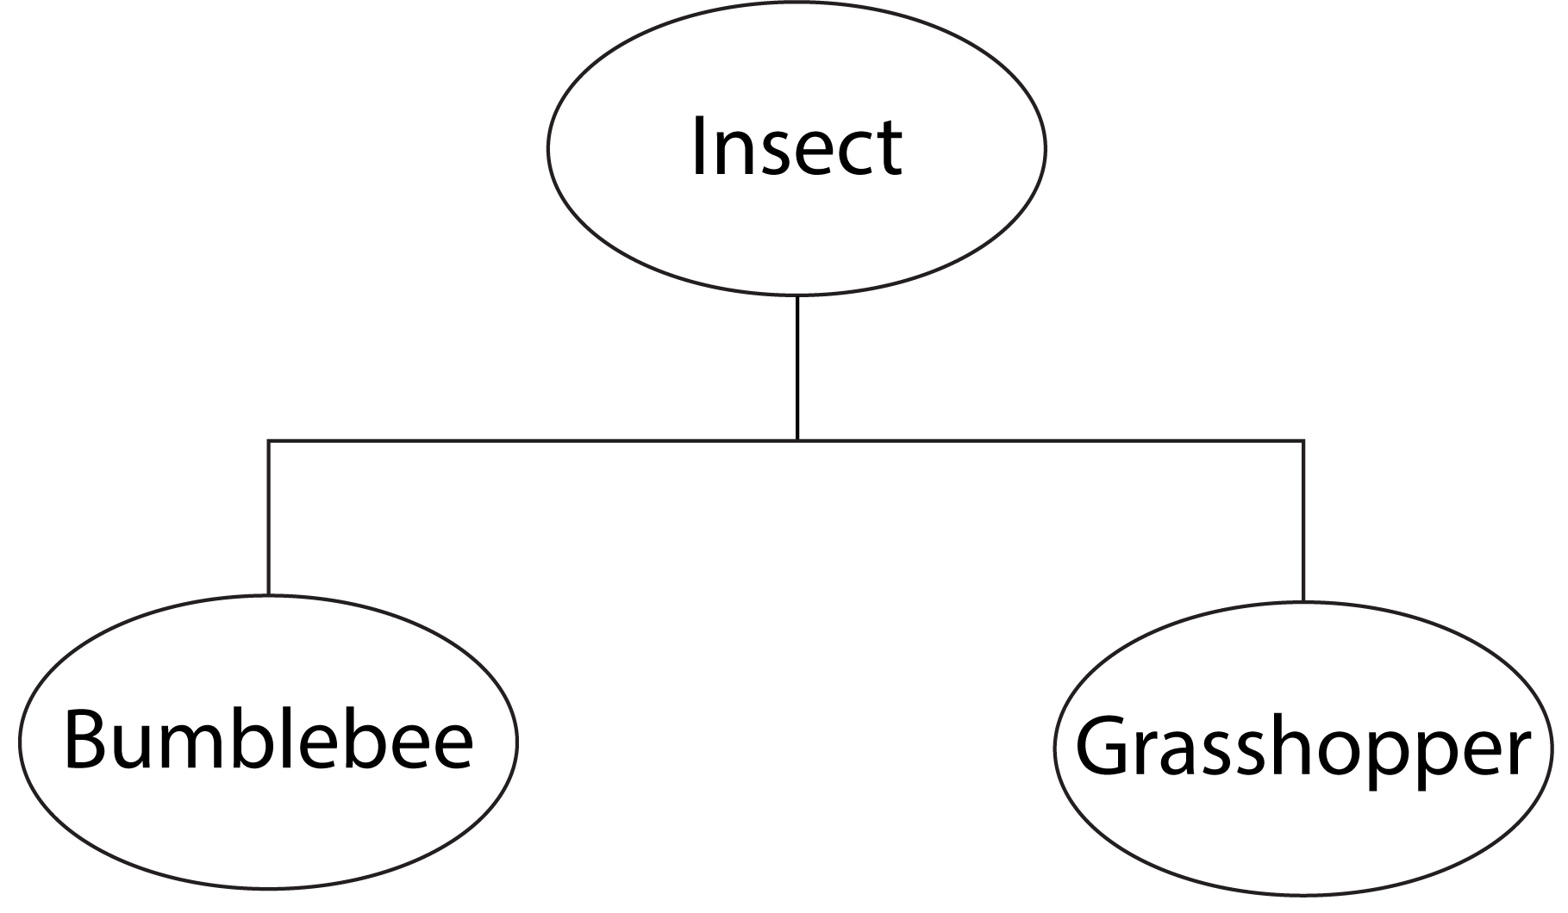
“Is a” Relationship (1 of 2)
When one object is a specialized version of another object, there is an “is a” relationship between them.
A grasshopper is an insect
A bumblebee is an insect
The logic is:
All insects have certain common characteristics and can be described by an insect class
The grasshopper has its own unique characteristics to be described by a grasshopper class
The bumblebee has its own unique characteristics to be described by a bumblebee class

Slide 4
“is a” Relationship (2 of 2)
An “is a” relationship implies that the specialized object has all the characteristics of the generalized object.
The specialized object has additional characteristics that make it special, which the generalized object does not have
In object-oriented programming, inheritance creates an “is a” relationship among classes when you declare a class to be a specialized class of another.
specialized “is a” generalized
This allows you to extend the capabilities of a class by creating another class that is a specialized version of it.

Slide 5
Base and Derived Classes
Inheritance involves base and derived classes.
The base class is the generalized class and is sometimes called a superclass
The derived class is the specialized class and is sometimes called a subclass
You can think of the derived class as an extended version of the base class
The derived class inherits fields, properties, and methods from the base class without any of them having to be rewritten
New fields, properties, and methods may be added to the derived class to make it special

Slide 6
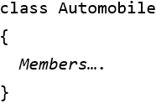

Inheritance Notation
Assume there exists an Automobile class:
In C# the generic format to declare inheritance in the class header:
where Car is the derived class and Automobile is the base class
the colon (:) indicates that this class is derived from another class

Slide 7
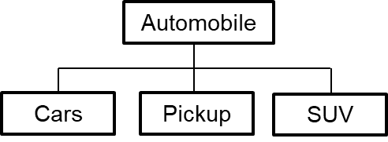
Examples
A dealership’s inventory include three types of automobiles: cars, pickup trucks, and S U V s
The dealership keeps the following data:
Make
Year model
Mileage
Price
Each type of vehicle that is kept in inventory has the above general data
Each type of vehicle also has its own specialized data as shown below:
Items | Cars | Pickups | S U V s
Specialized data | Number of doors | Drive type | Passenger capacity

Slide 8
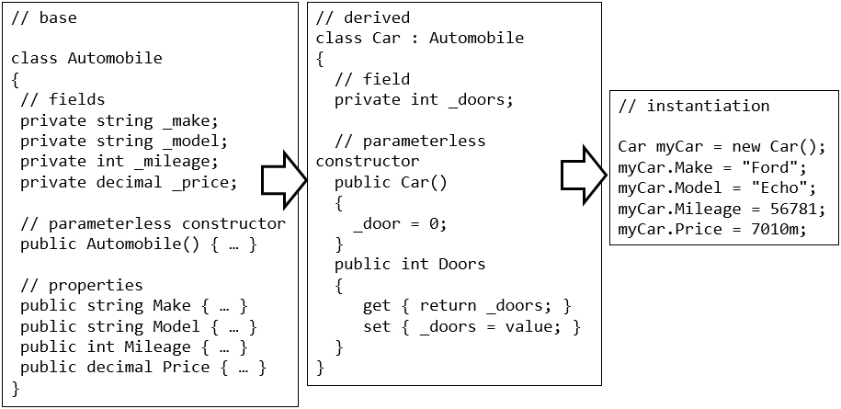
Sample Code

Slide 9
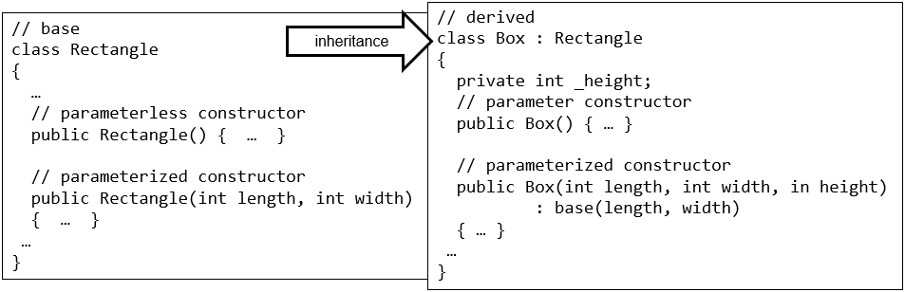
Base Class and Derived Class Constructors
When you create an instance of a derived class:
the base class constructor is executed first
the derived class constructor next
by default the base class’s parameterless constructor is automatically executed

Slide 10

Constructor Issues in Inheritance (1 of 2)
If you want a parameterized constructor in the base class to execute, or
if the base class does not have a parameterless constructor,
you must explicitly call the base class’s parameterized constructor using the base keyword
The above example calls the base class’s parameterized constructor, passing length and width as arguments

Slide 11
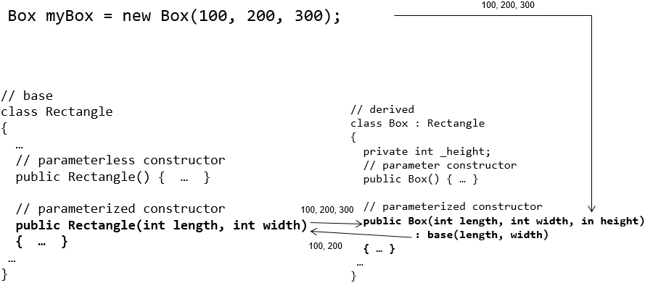
Constructor Issues in Inheritance (2 of 2)

Slide 12
Protected Members (1 of 2)
In an inheritance relationship, the private members of a base class cannot be accessed by code in a derived class.
When a base class member needs to be private to all outside code except derived classes, you can declare that member as protected.
A protected member of a class may be accessed by methods of the same class or methods of a derived class.

Slide 13
Protected Members (2 of 2)
In the following example, the idNumber field is declared as protected.
Any class that is derived from the Person class will have access to the idNumber field.
class Person
{
protected int idNumber;
public Person(int id, string name)
{
idNumber = id;
Name = name;
}
public string Name { get; set; }
public override string ToString()
{
return $"{idNumber} {Name}";
}
}

Slide 14
Restricting Inheritance with the sealed Keyword
If a class is declared with the sealed keyword, no other classes can be derived from it.
A compiler error will occur if a class tries to use a sealed class as a base class.
General format:
sealed class YourClass
{
// Member declarations
}

Slide 15
Polymorphism
The term polymorphism refers to an object’s ability to take different forms.
It allows derived classes to have methods with the same names as methods in their base classes
It allows a program to call the correct method, depending on the type of object that is used to call it
When a derived class inherits from a base class, it gains all the methods, fields, properties, and events of the base class
To change the data and behavior of a base class, you have an option to override a virtual base member

Slide 16
Essential Ingredients of Polymorphism
Two essential ingredients of polymorphic behavior:
The ability to define a method in a base class and then define a method with the same name in a derived class
The derived class overrides the base class method
The ability to call the correct version of an overridden method, depending on the type of object it is used to call it
If a derived class object is used to call an overridden method, then the derived class's version is the one that executes
If a base class object is used to call an overridden method, then the base class’s version is the one that executes

Slide 17
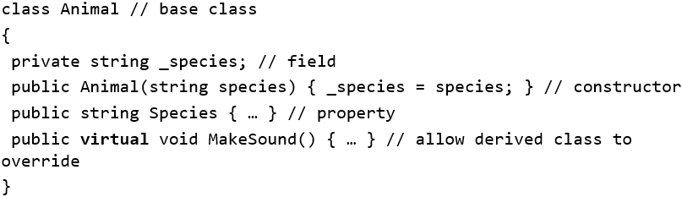
Polymorphism (1 of 2)
The keyword virtual is used to declare that a derived class is allowed to override a method of a base class
To create an Animal object, your only option is:

Slide 18
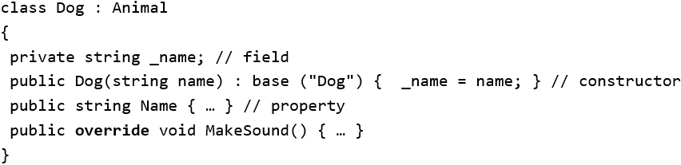
Polymorphism (2 of 2)
The keyword override declares that this method overrides a method in the base class
To create an Animal object, your options are:

Slide 19
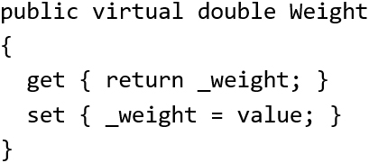
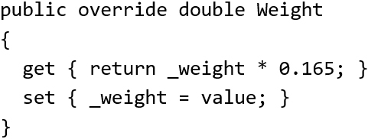
Overriding Properties
Properties in a base class can be overridden in the same way that methods can be overridden.
To override the property in the derived class you use the override keyword.

Slide 20
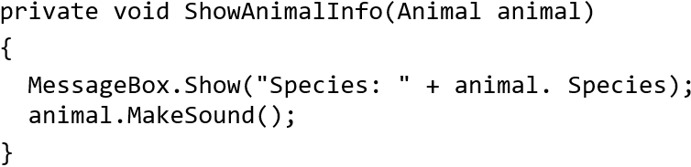

Passing Objects to Base Class Parameters
Given the following method of a derived class:
This method has an Animal variable as its parameter. You can pass an Animal object to the method:
The method can display the object's Species property and calls its MakeSound method
Due to polymorphism, you can also pass a Dog object as argument to the ShowAnimalInfo method:

Slide 21
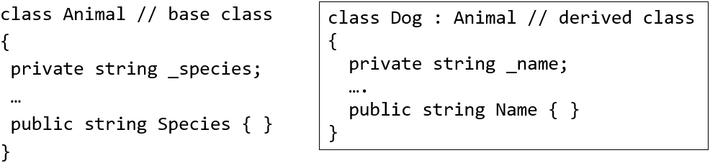

Base Class Reference
A base class reference variable can reference an object of any class that is derived from the base class.
A base class reference variable knows only about the members that are declared in the base class.
If the derived class introduces additional methods, properties, or fields, a base class reference variable cannot access them.

Slide 22
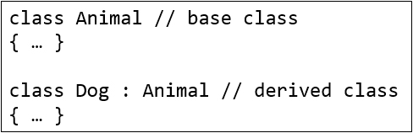
The “is a" Relationship Does Not Work in Reverse
It is important to understand that the “is a” relationship does not work in reverse
A dog is an animal. Yet, “an animal is a dog” is not always true.
You cannot assign an Animal reference to a Dog variable because Dog is a derived class

Slide 23
Summary of Polymorphism Issues
In order for an instance of a derived class to completely take over a class member from a base class, the base class has to declare that member as virtual.
Fields cannot be virtual
Only methods, properties, events and indexers can be virtual
A derived class then has the option of using the override keyword to replace the base class implementation with its own.

Slide 24
Preventing Method Overriding with the sealed Keyword
If a method is declared with the sealed keyword, it cannot be overridden in a derived class.
A compiler error will occur if a class tries to override a sealed method.
Example:
public sealed void Message()
{
// Code goes here
}

Slide 25
Abstract Classes (1 of 2)
In certain applications, some base classes are not intended to be instantiated to create objects.
They are designed solely for the purpose of providing an outline for subclasses. For example:
a Student class that describes what is common to all students, but does not provide details for students majoring in Computer Science
The Student class is intended to be a base class that can be derived by the Computer Science class
An abstract class serves as a base class but is not instantiated itself.
It only provides some class members to its derived classes

Slide 26

Abstract Classes (2 of 2)
To declare a class as abstract, use the abstract keyword in the class header. For example:
The abstract keyword indicates that a class is intended only to be a base class of other classes.
The primary differences between an abstract class and a regular class (aka concrete class) are:
An abstract class cannot be instantiated
A concrete class can be instantiated

Slide 27
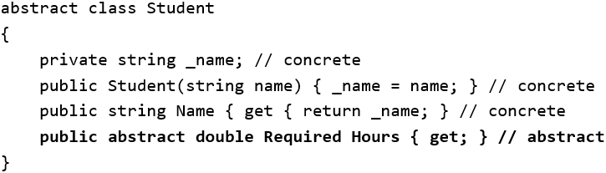
Members of Abstract Classes
An abstract class can have abstract and concrete members. For example:

Slide 28
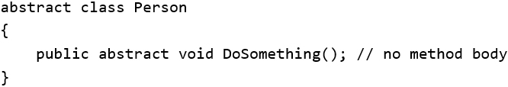
Abstract Methods
Abstract classes can contain abstract methods.
An abstract method has only a header and no body
It must be overridden in a derived class
To create an abstract method, use the abstract keyword before the return type

Slide 29
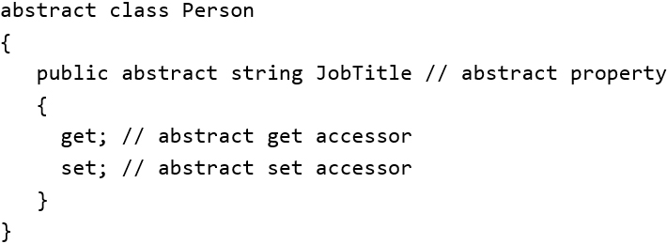
Abstract Properties
Abstract classes can also contain abstract properties.
An abstract property is a property that appears in a base class
Abstract properties are expected to be overridden in a derived class
To create an abstract property, use the abstract keyword before the property type
To create an abstract read-only property, leave out the set accessor.

Slide 30
Extension Methods
An extension method is a static method that extends an existing class or data type.
Includes classes and types in .NET
May be used to extend a class from .NET or a class written by someone else.
Extension methods can be applied to classes, structs, and interfaces (see later slides) as well as to primitive data types like int or double.

Slide 31
Extending the int data type (1 of 2)
To extend the int data type to tell whether a variable is odd or even, create an extension method and apply it to the int data type
Define an IsEven extension method:
namespace ExtensionMethods
{
public static class Extensions
{
public static bool IsEven(this int i)
{
return (i % 2) == 0;
}
}
}

Slide 32
Extending the int data type (2 of 2)
In the following code, when the IsEven method executes, the myValue variable will implicitly be passed to the i parameter.
int myValue = 4;
if (myValue.IsEven())
{
MessageBox.Show(“The number is even.”);
}
An extension method can have multiple parameters. The this keyword appears only before the first parameter.

Slide 33
Interfaces (1 of 3)
An interface specifies behavior for a class.
It is like a class that contains only abstract methods and/or abstract properties.
It cannot be instantiated but is, instead, implemented by other classes.
When a class implements an interface, the class must provide all the methods and properties specified by the interface.

Slide 34
Interfaces (2 of 3)
General format of an interface definition:
Public interface InterfaceName
{
Method headers and/or Properties...
}
Example of interface named IDisplayable:
Interface IDisplayable
{
void Display();
}
Note: all methods and properties declared in an interface are implicitly public.

Slide 35
Interfaces (3 of 3)
Example of class Person that implements the IDisplayable interface:
Class Person : IDisplayable
{
// Name property
public string Name { get; set; }
// Constructor
public Person(string n)
{
Name = n;
}
// Display method, required by IDisplayable
public void Display()
{
MessageBox.Show(“My name is “ + Name);
}
}

Slide 36
Interface Properties
When a class implements an interface that has a property, the class must provide that property with the accessors that are listed in the interface.
For example, any class that implements the following interface must provide a decimal property named Cost, with a get and set accessor:
interface IInventory
{
decimal Cost { get; set; }
}

Slide 37
Read-Only Interface Properties
When a class implements an interface that has a property, the class must provide that property with at least the accessors that are specified in the interface.
This means that omitting the set accessor in an interface property does not guarantee the property will be read-only in the classes that implement the interface.
To be sure that an interface property is implemented as read-only, specify an init accessor in the interface.
interface IInventory
{
decimal Cost { get; init; }
}

Slide 38
Creating an Interface in Visual Studio
With the project open in Visual Studio, click Project on the menu bar and then select Add New Item…
From the Add New Item window, select Code in the left pane, select Interface in the center pane, and change the default name in the Name box at the bottom of the window to whatever you want.
Click the Add button to create the new source code file in the project.
An empty interface is automatically created and placed in the project’s namespace.

Slide 39
Multiple Interfaces
Interfaces are similar to abstract classes.
While a class can only inherit from one base class, C# allows a class to implement multiple interfaces.
When a class implements multiple interfaces, it must provide the methods and properties specified by all the interfaces.

Slide 40
Restrictions of Interfaces
You cannot declare any fields within an interface
Properties declared in an interface are abstract; they can contain only get and/or set keywords
Methods declared in an interface are abstract; they cannot contain any code
All members of an interface are public; you cannot list an access modifier with any property or method in an interface
Interfaces cannot have a constructor
You cannot declare a class, structure, enumeration, or other interface inside an interface
Interfaces can only inherit from other interfaces; an interface cannot inherit from a class

